Slide 1
Study Of Life Expectancy and Hospital Closures
By: Ben, Robert And John

Slide 2
Project summary
We wanted to see the effect of hospital closures on life expectancy. We expected that if a hospital closes, then the life expectancy in a country would decrease. We were able to find data from the Global Health data exchange on life expectancy in the US from 1980 to 2014 and hospital closures from 2006 to the 2014. We were able to clean the data and use Geopandas to visualise the data.

Slide 3
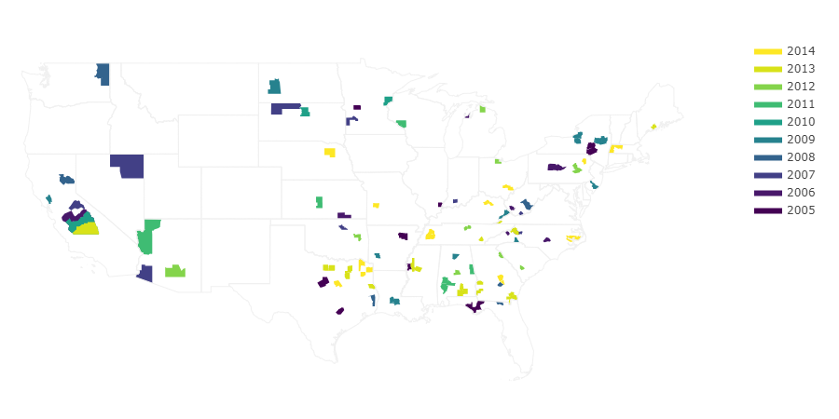
Hospital Closings

Slide 4
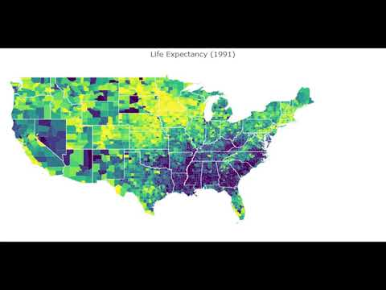
1980 - 2014 Data Map
Video:

Slide 5
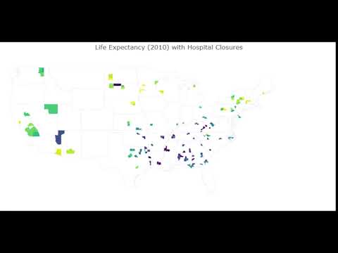
Closure counties only

Slide 6
What does the data tell us?
Drum roll… not much! There does not appear to be a strong visual correlation between hospital closures and decrease in life expectancy.
However - decrease in life expectancy for Southern States as a region
Limitations:
Source methodology
Factors not taken into account
Possible avenues to explore further

Slide 7

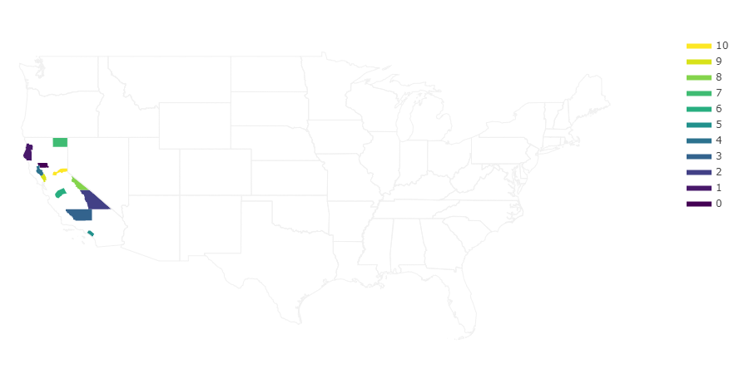
Programs used
GeoPandas
Plot.ly

Slide 8
Citations
University of North Carolina - Cecil G. Sheps Center for Health Services Research
Hospital Closure data
https://www.shepscenter.unc.edu/programs-projects/rural-health/rural-hospital-closures/
Nic Colley - data.world contributor
US Zipcode to County State to FIPS Look Up
https://data.world/niccolley/us-zipcode-to-county-state
The Institute for Health Metrics and Evaluation
http://ghdx.healthdata.org/us-data

